Slide 1
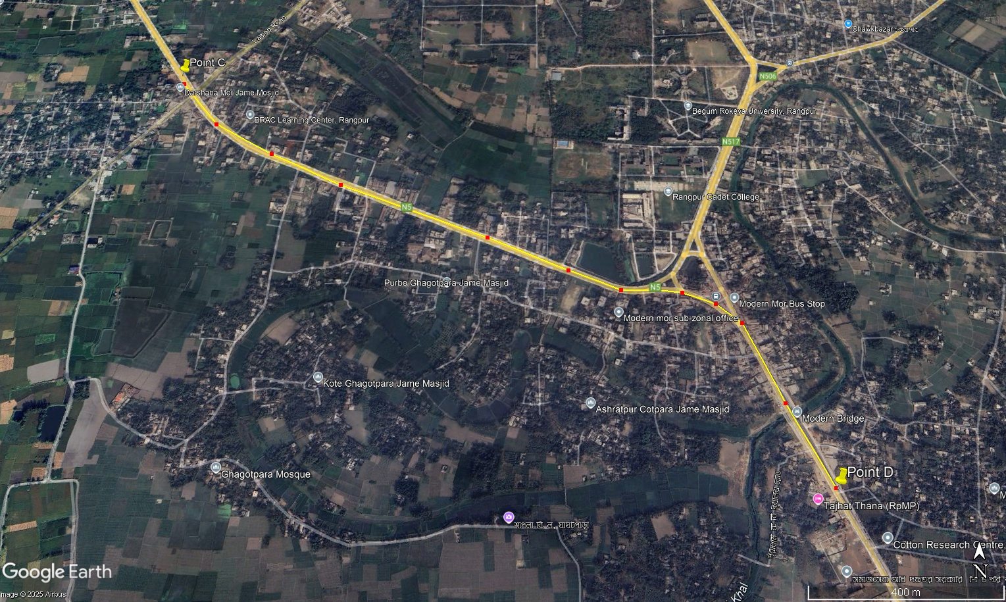

Slide 2
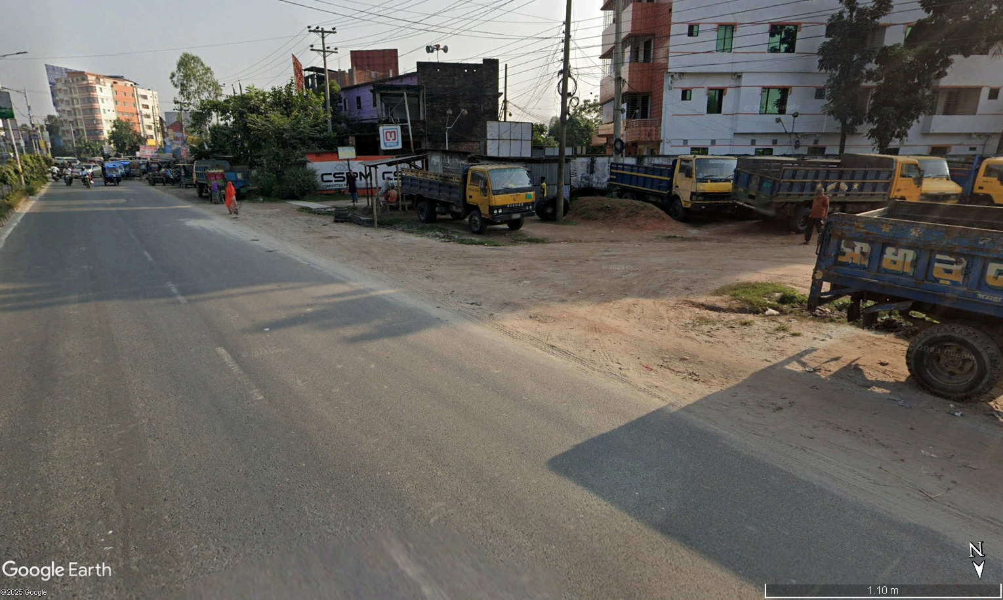
-Land used as truckstand, but no road signs
-No safety for pedestrian

Slide 3
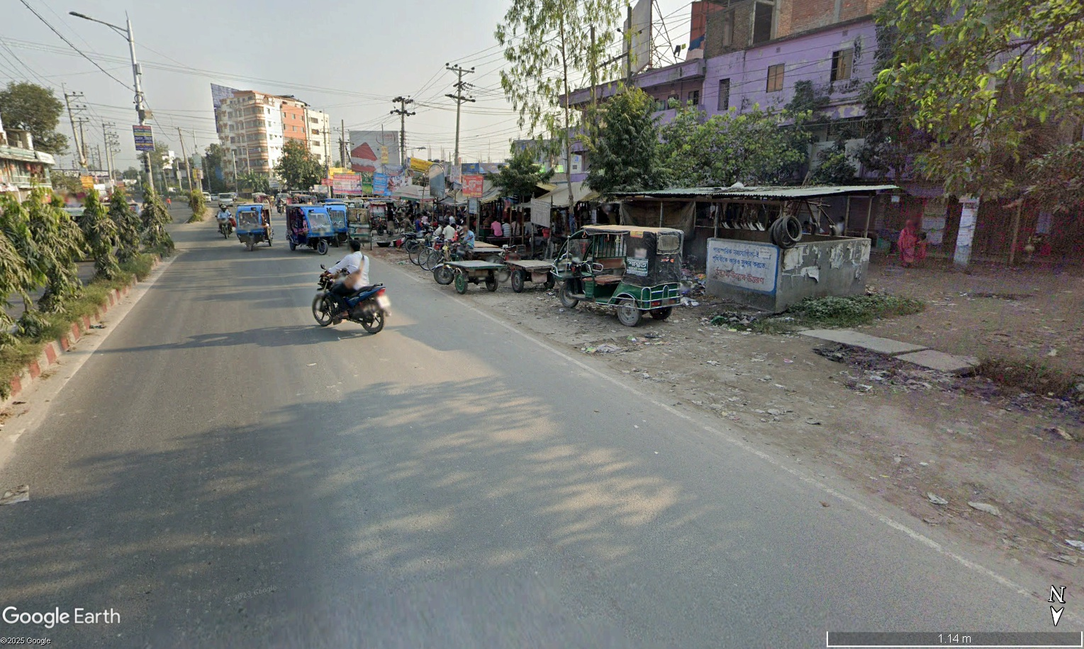
-Roadside are occupied by illegal shopkeepers
-Nonmotorized vehicle is parked
-In this road bike take wrong way for changing side

Slide 4
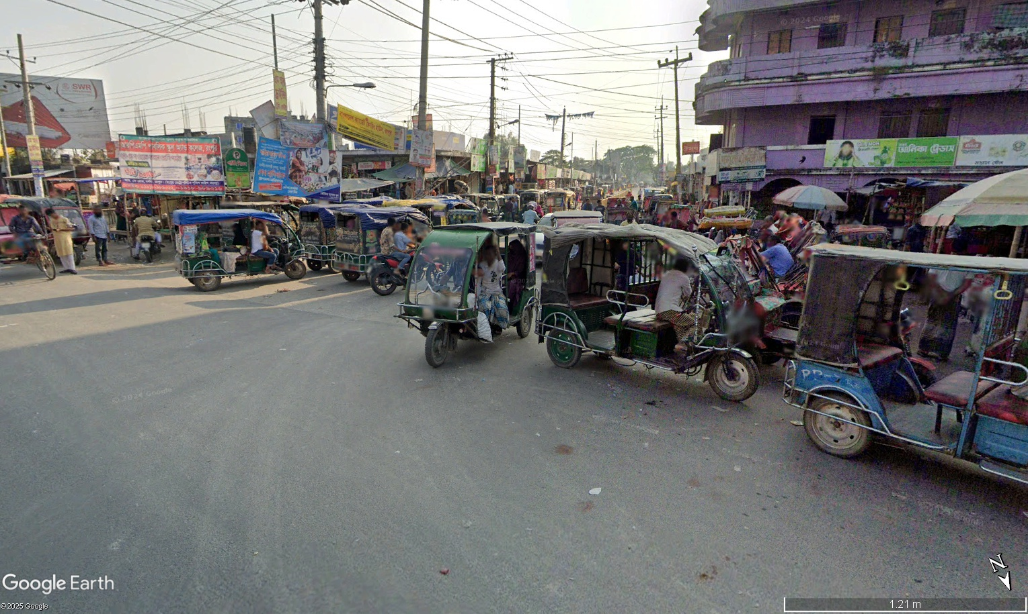








Do not have any clear position for placing any sign
Road marker are faded away
-Semi motorized and non motorized vehicle reduce the capacity of highway
-This vehicles are stopped in intersection for parking or taking passenger, create bottleneck

Slide 5
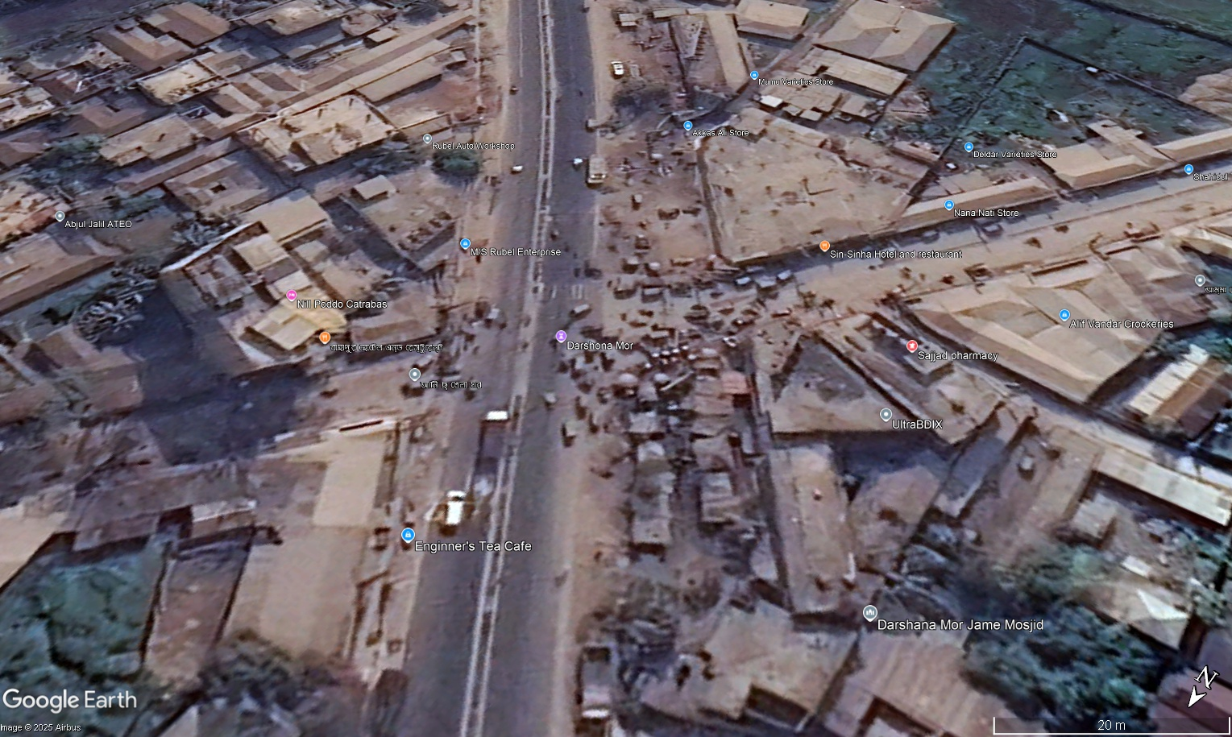




-Existing Road alignment is not proper
-U turn create bottleneck and cause of accident in this intersection

Slide 6
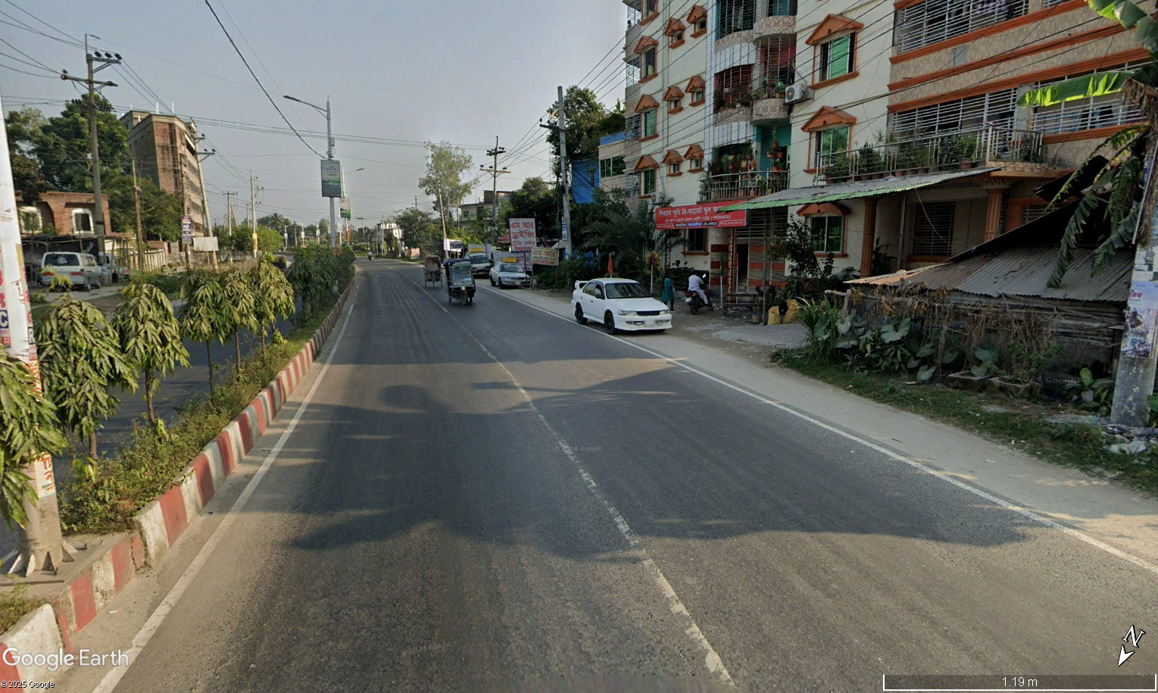
-Pre-School is ahead, but no Warning signs anywhere
- Wrong Land use. High number of Pedestrian cross the road for taking vehicle of opposite direction, But there is no zebra crossing
- There is no speed bumper though there is a pre-school ( Though speedbumper reduce mobility of the highway, but it increase safety for the childrens)

Slide 7
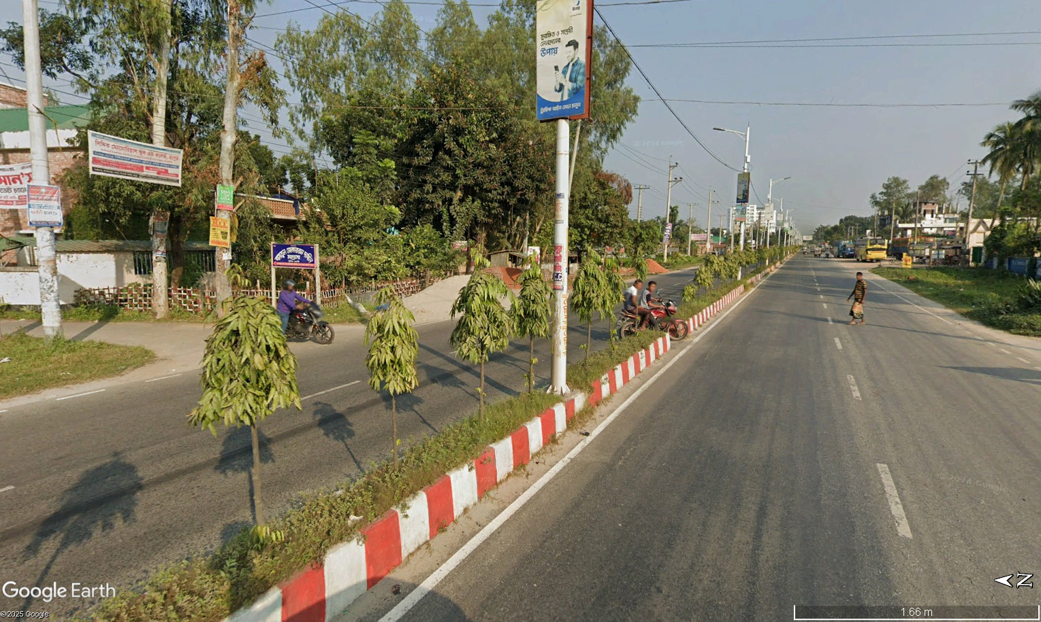
- Madrasa is ahead, But no warning sign
- Pedestrian cross the road all the time.
- Vehicle often take u turn here, but no proper warning, and less visibility due to tree of the median

Slide 8
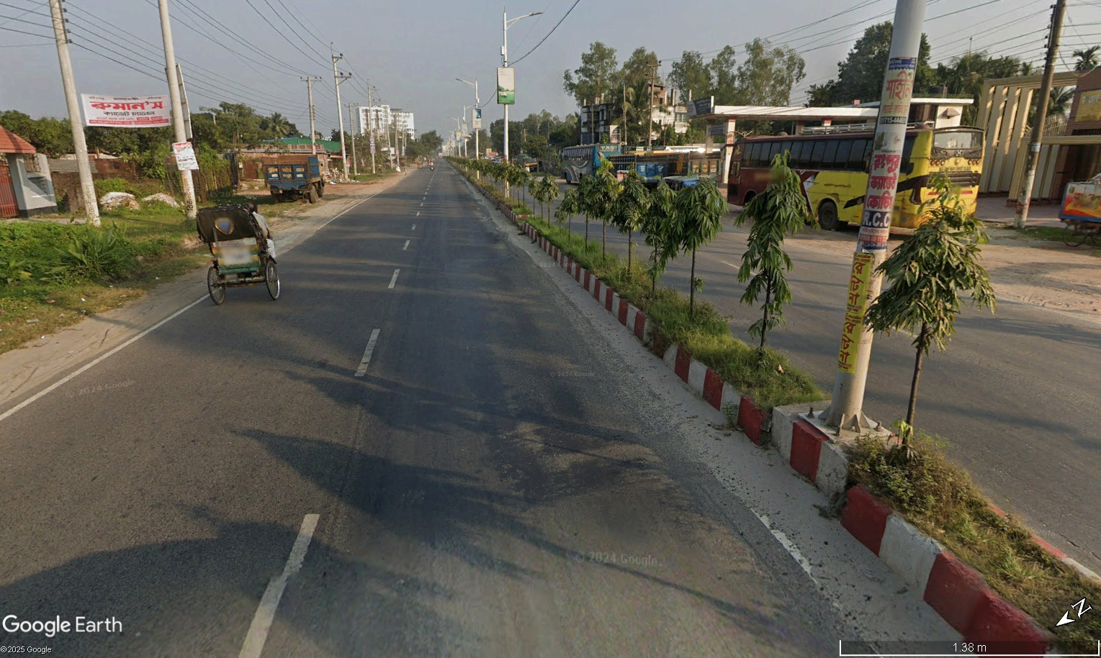
Non-motorized vehicle use the highway, which create bottleneck

Slide 9
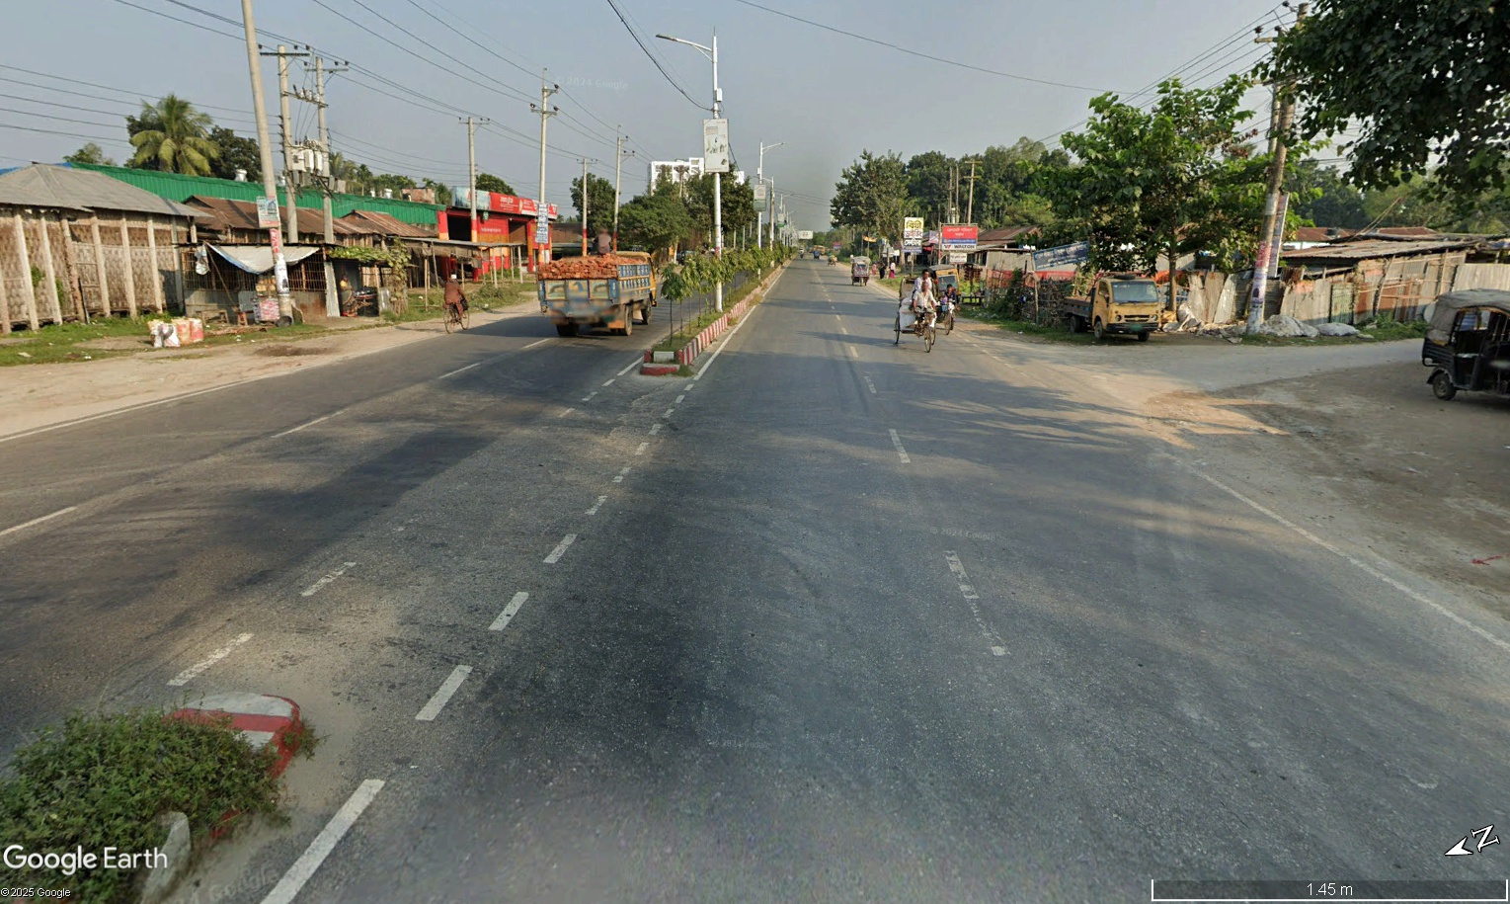
Road markers are faded

Slide 10
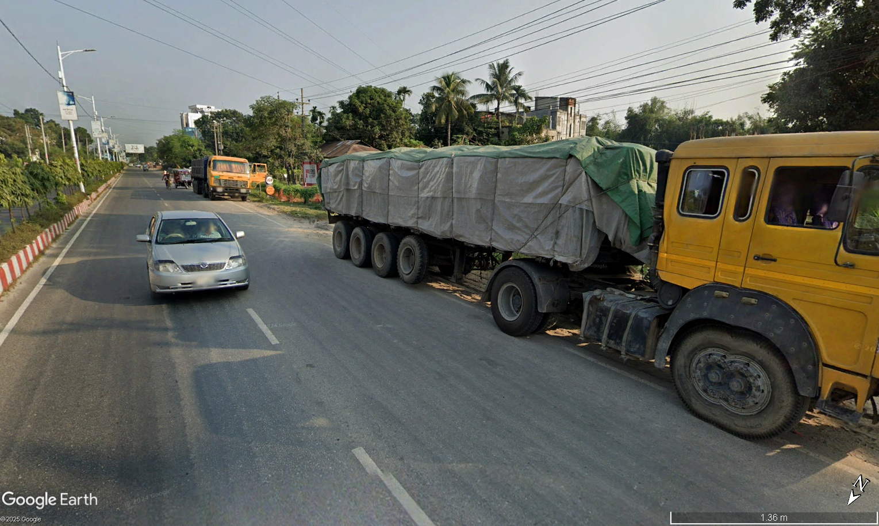
- Truck are parked in the both side of this highway, which increase road friction

Slide 11
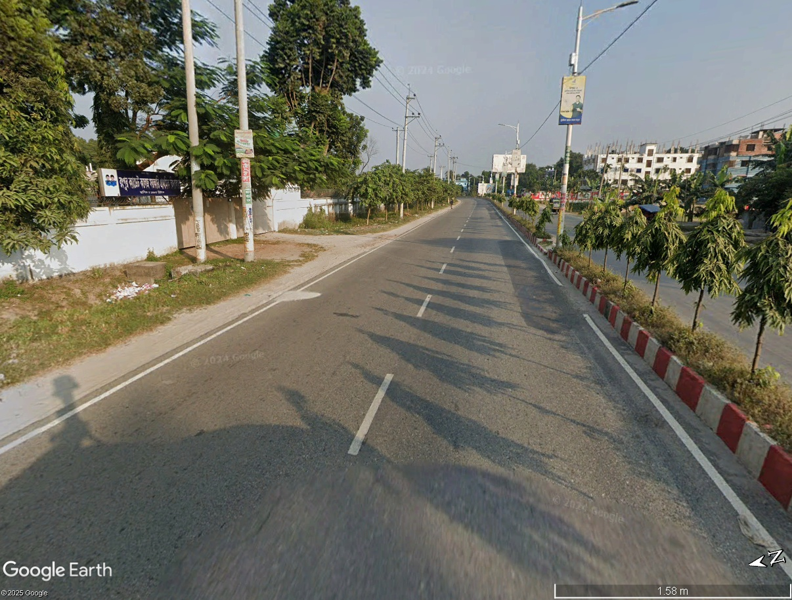
- It is very surprising nowhere warning sign is used before any school/college, though it is a national highway.
- Land use is wrong
- Students cross the road always, but there is no zebra crossing.( Safety vs mobility paradox)

Slide 12
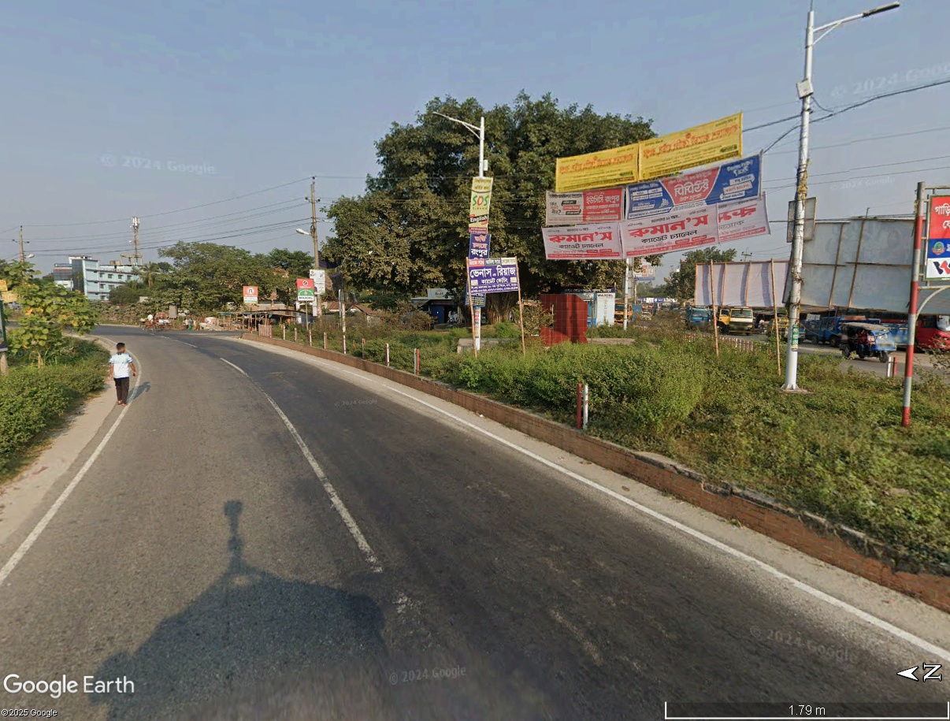
Iland is not clear.

Slide 13
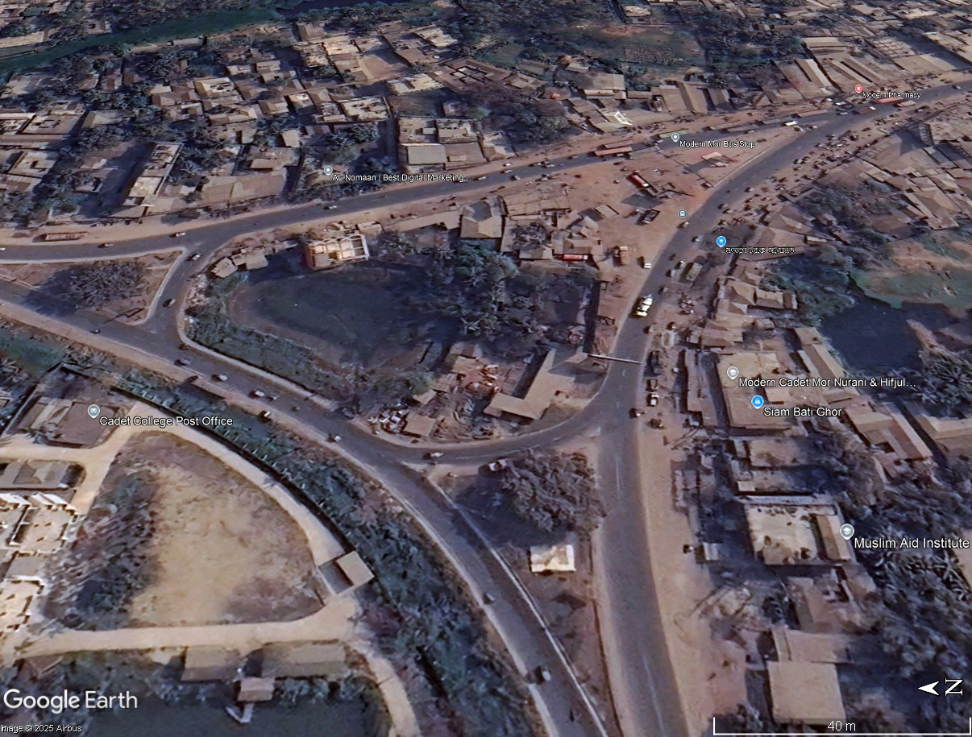







Slide 14
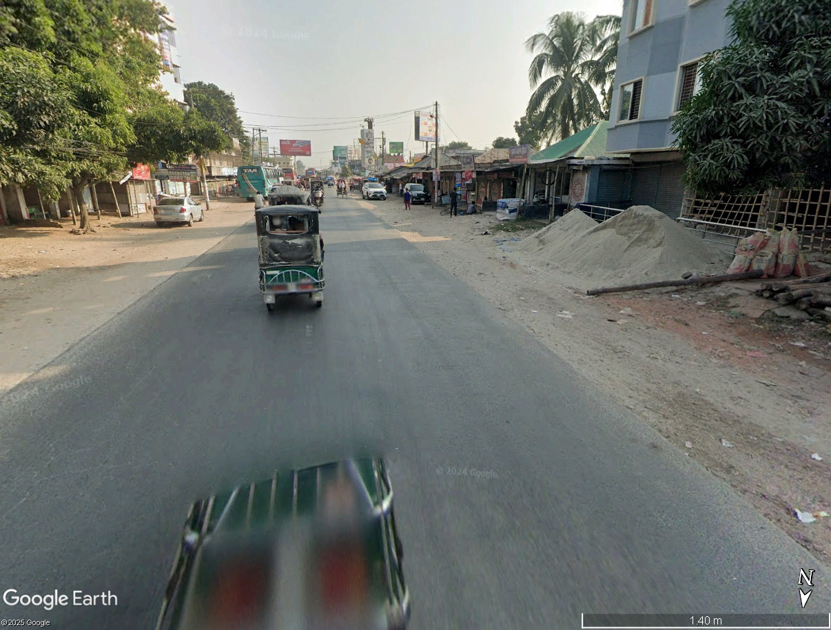
This road do not maintain standard cross section, no-drainage, water-logging issue occur after rain

Slide 15
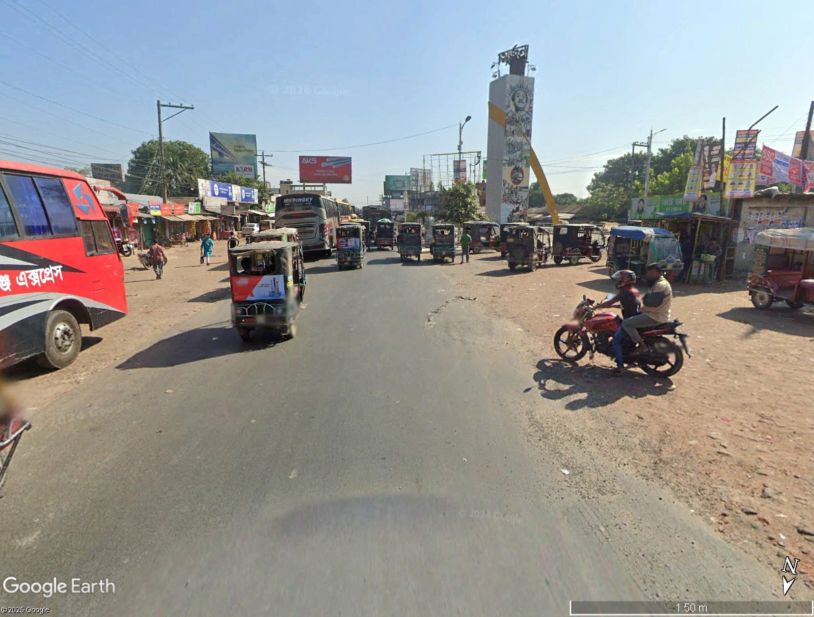






Slide 16
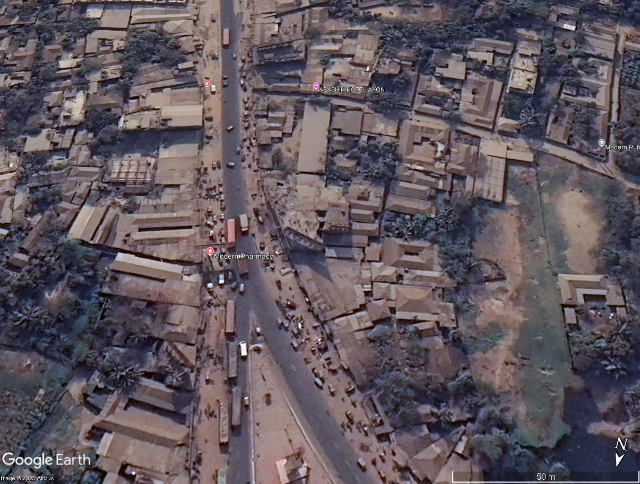




illegal parking, shop , creating side friction
buses are blocking the road, used as busstand
Roads are not access controlled

Slide 17
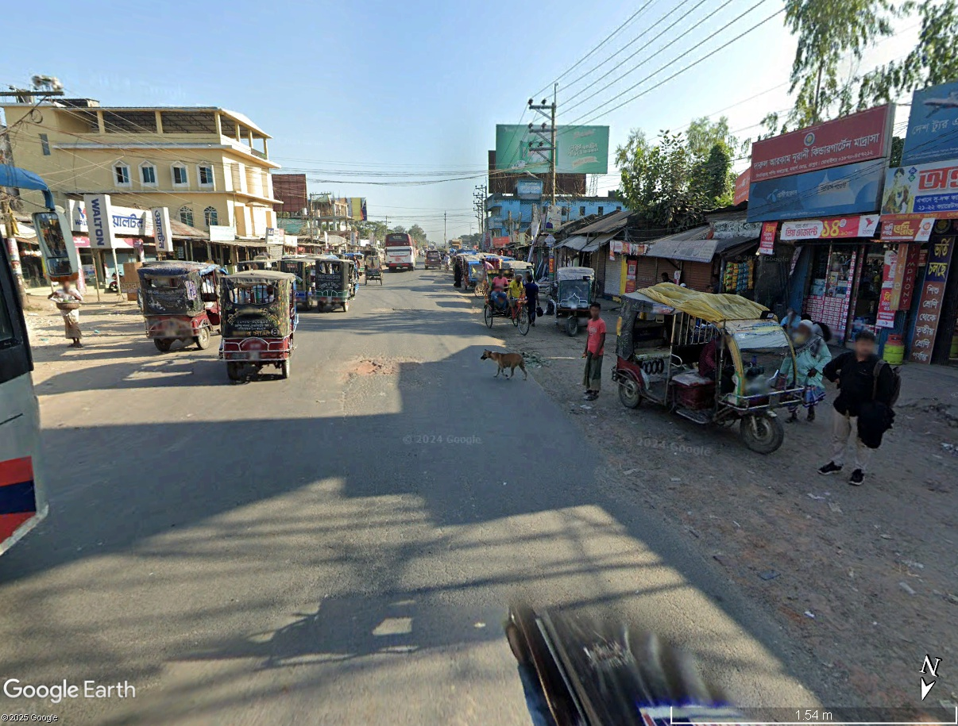




Slide 18
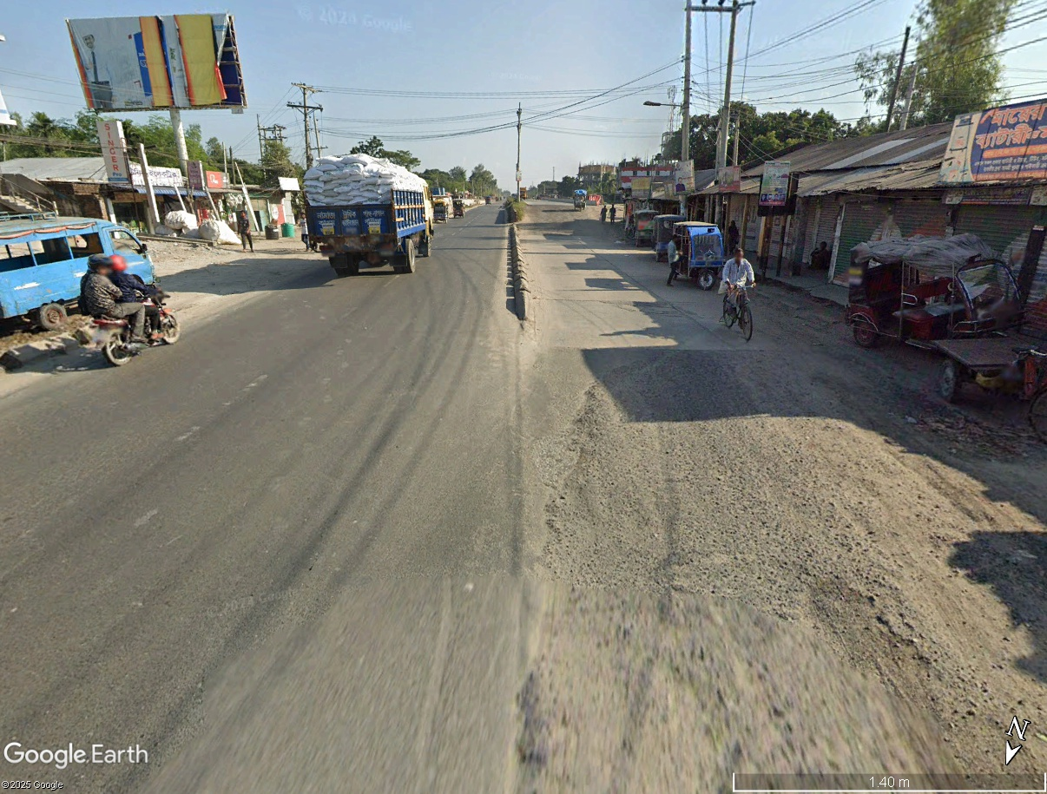
the design of road divider is not good, not visible from a distance

Slide 19
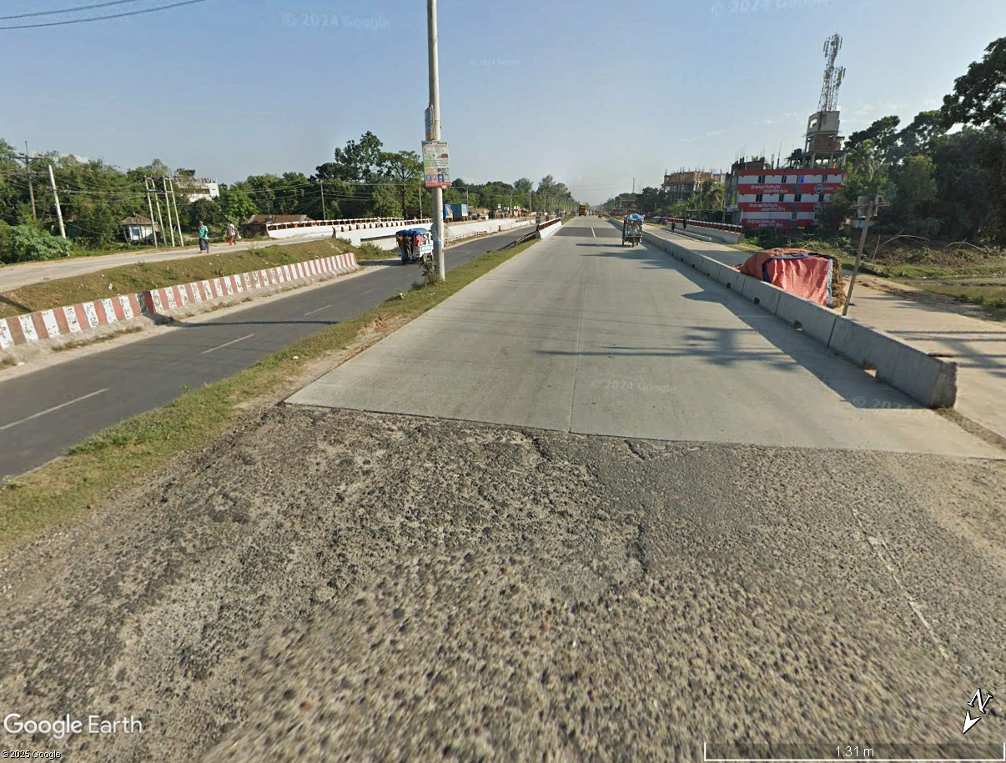




Improper placement of Electric-pol will create fatal crash in highway
temporary storage is the middle of the highway may cause fatal crash

Slide 20
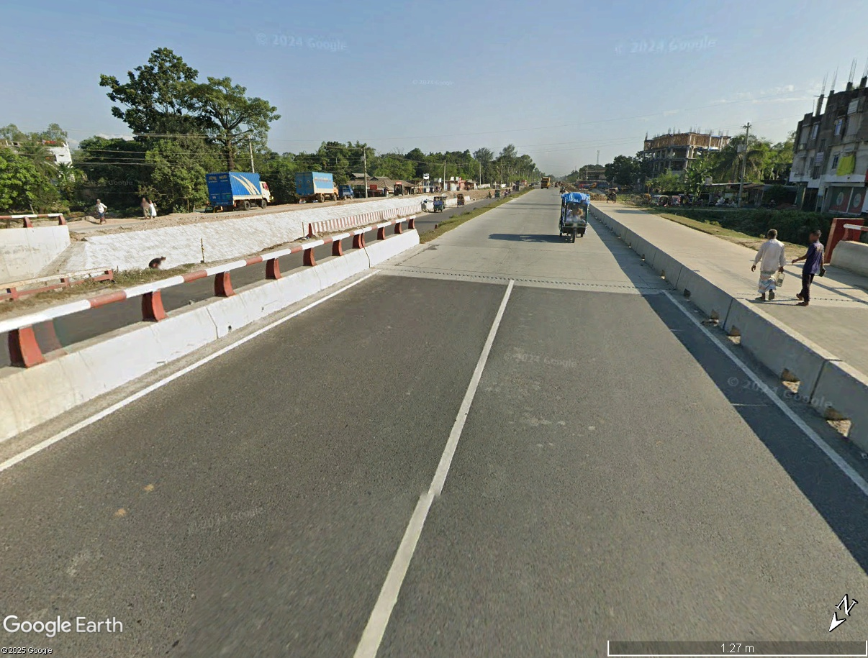
Sides of the bridges should have enough footpath in this location

Slide 21
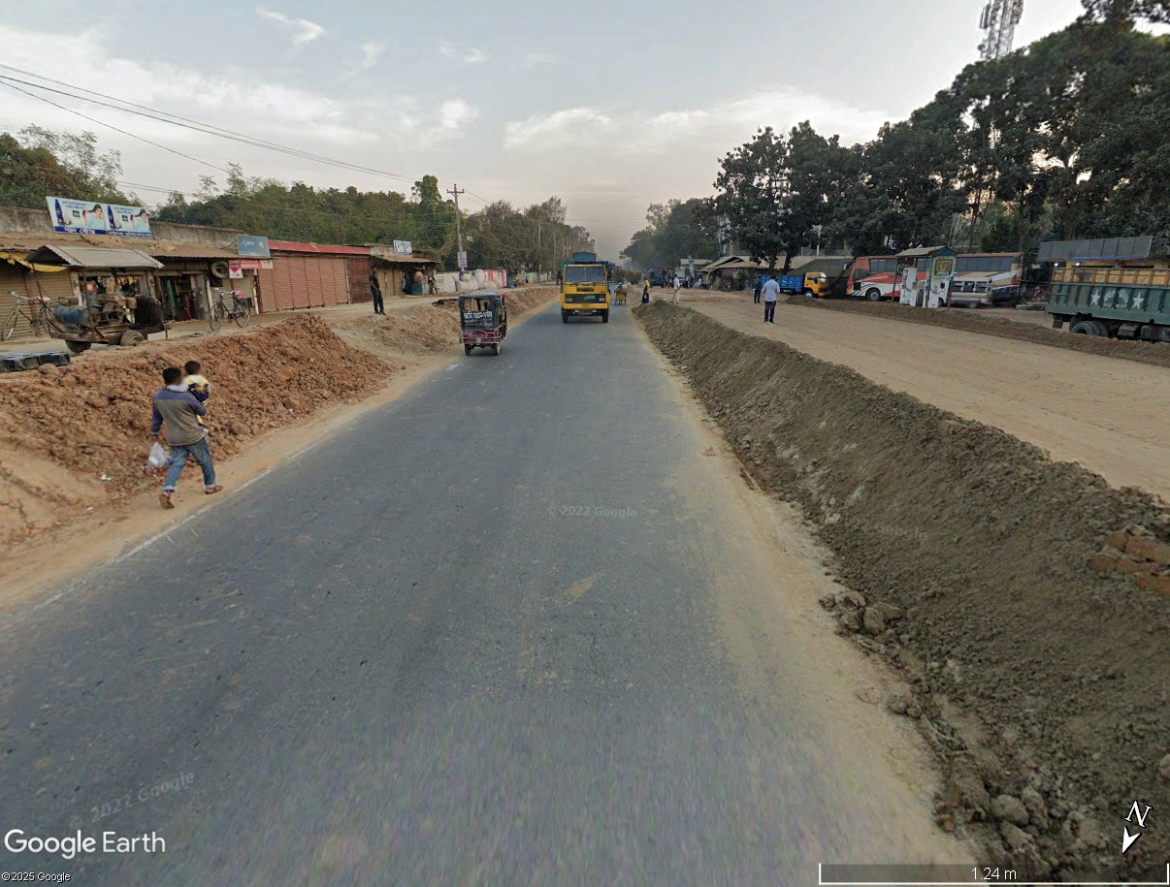
Construction work is going on, but no warning sign

